Slide 1
For Live Session
Unit 4
Carlos estevez

Slide 2
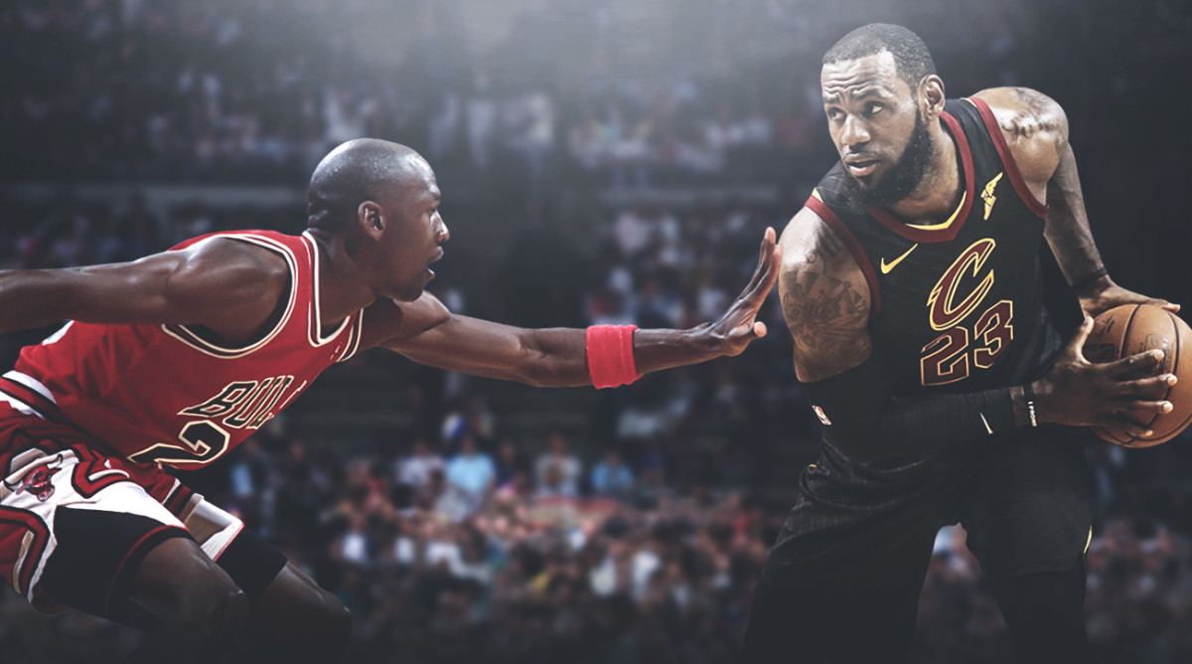

Exploratory data analysis(EDA)
LBJ vs MJ(Using nbastatR) f
For a long time we have considered Michael Jordan as the best NBA player of all time, nevertheless a current star has complicated that GOAT (greatest of all time) conversation. There is an argument to be made for putting LeBron James over Jordan
For this assignment we have decided to use the API nbastatR to delve deeper into this controversial topic. The main idea is to show concrete evidence about who is really the best. We will take the following metrics into consideration for our final decision:
Accolades and Awards
Effectiveness(Defensiveness and Offensiveness)
Longevity

Slide 3
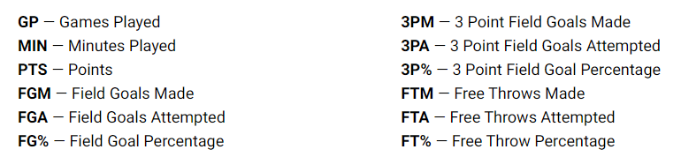
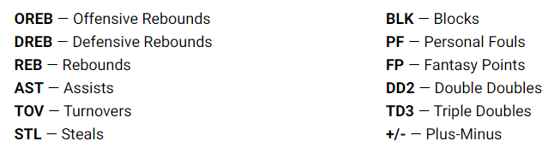
1.Glossary

Slide 4
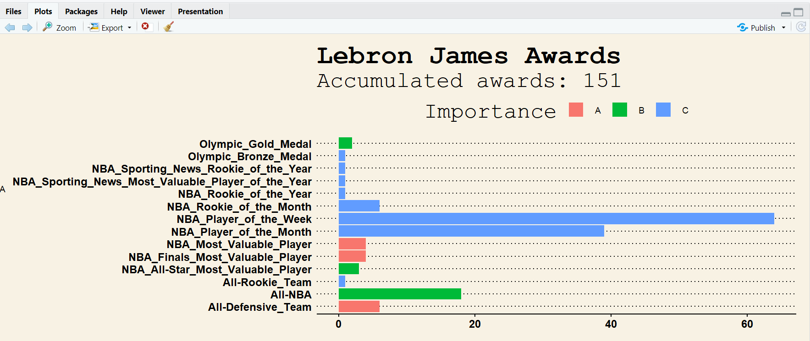
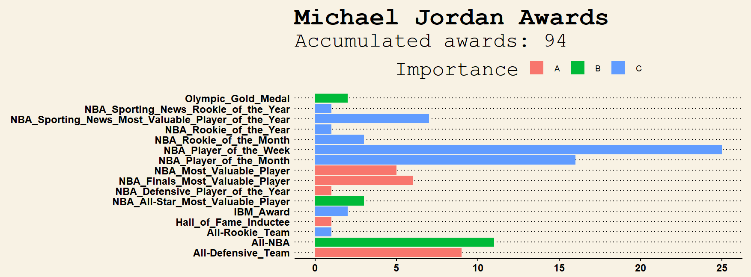
1.Accumulated Awards

Slide 5
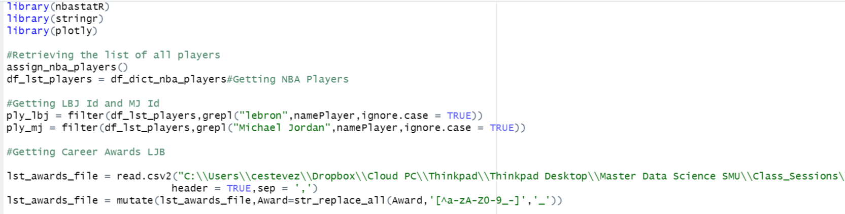
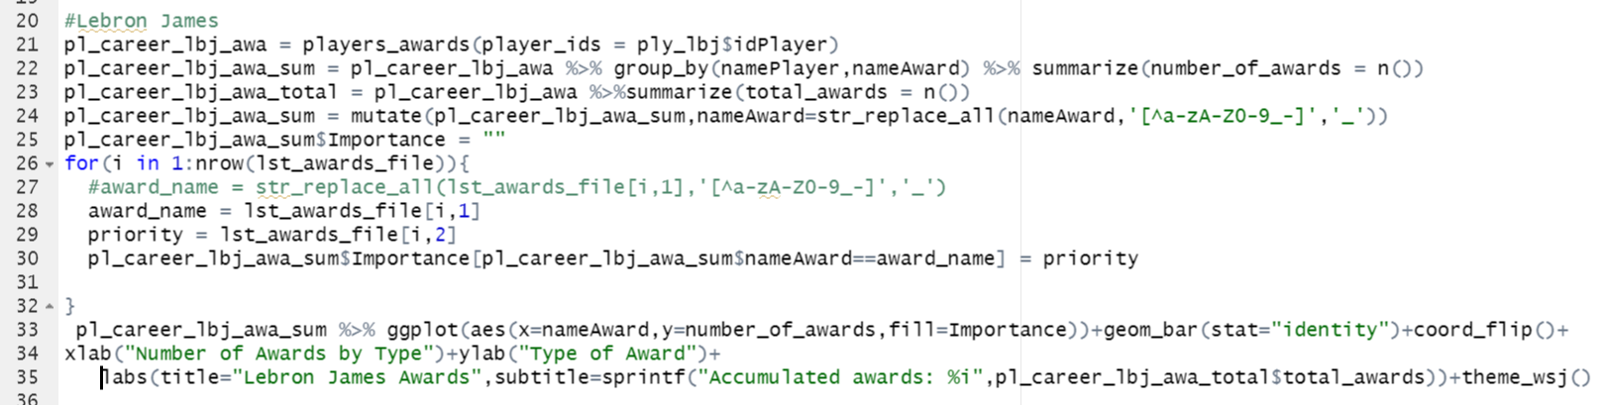
1.Accumulated Awards CODE
Loading the library
Getting the id and stat data of LBJ

Slide 6
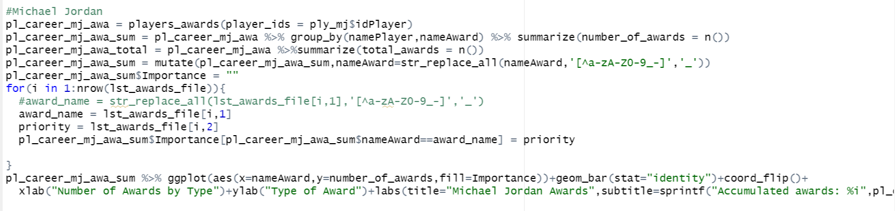
1.Accumulated Awards
Getting the data for MJ

Slide 7
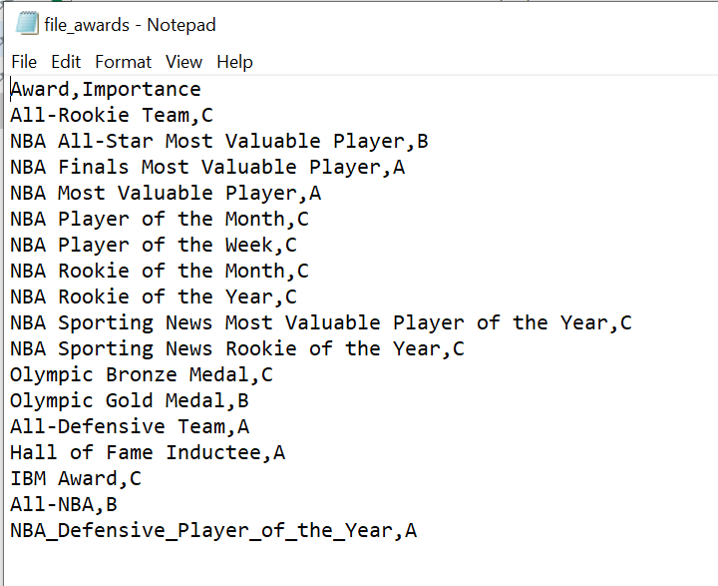
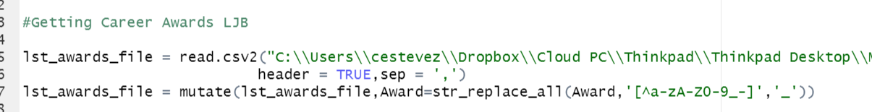
1.Importance of Awards
The library doesn’t provide a priority for the awards
We understand it was necessary giving a weight to every award. Therefore, we defined a file where we can indicate the priority for every award. It is really important to paste the same description as it appears in the API dataframe

Slide 8
1.Accumulated Awards
Conclusion:
It seems that LBJ has accumulated more awards than MJ over his career, however, when it comes to important awards he is clearly before MJ. According to the data, for example, LBJ has never won the defensive player of the year, which is a very important award
So even though LBJ has more awards, in terms of awards with high priority he is under Jordan’s accomplishments
The first data suggests that MJ is a better defensive player than LBJ, however, this might be confusing. We all know that LBJ is a very rounded player, including a great defender, even superior than Jordan.
Anyone who has watched NBA knows that LBJ has more rebounds and blocks than MJ. We need to delve deeper into the stats. So, let’s go to the following analysis.

Slide 9
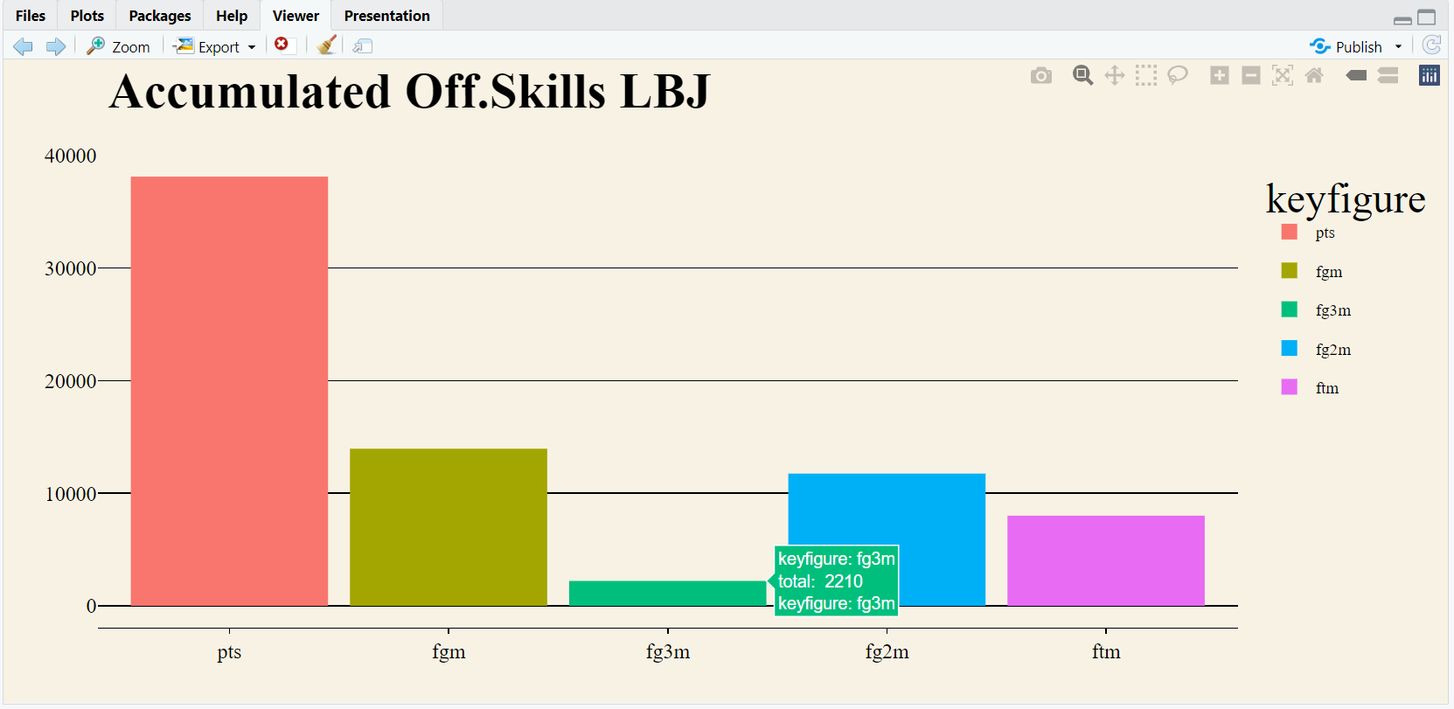
2-Offensiveness Accumulated

Slide 10
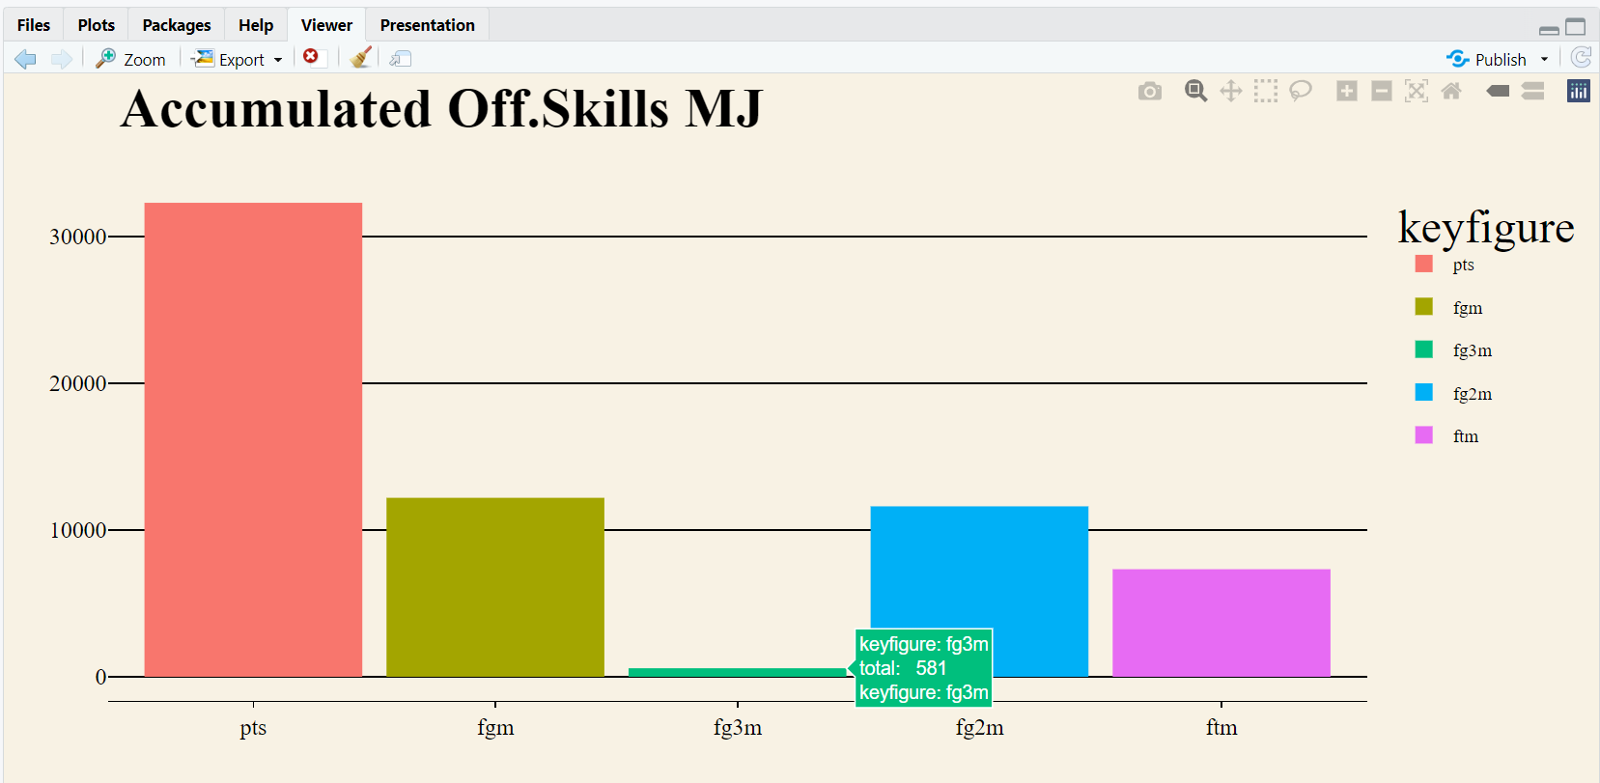
2-Offensiveness Accumulated

Slide 11
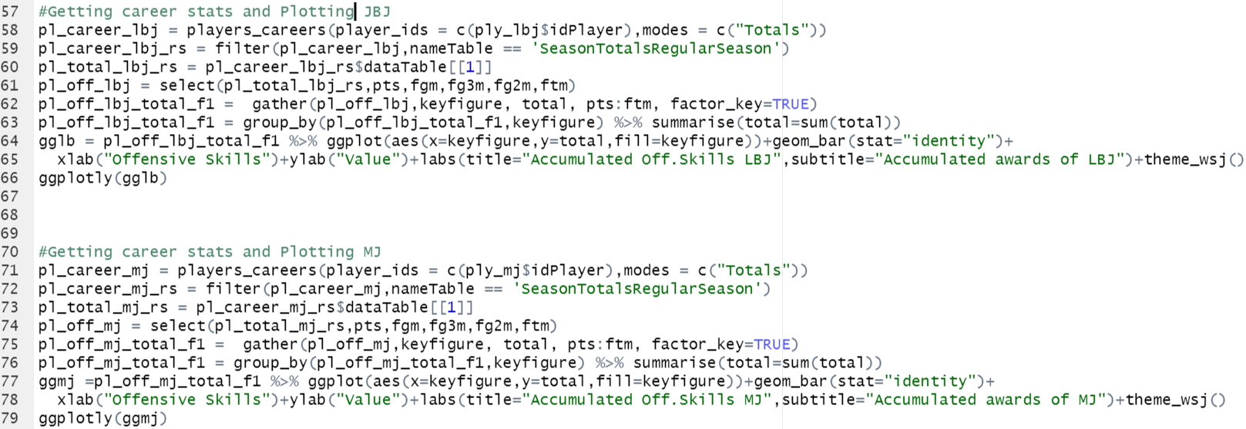
2-Offensiveness Accumulated
It was very tricky to get the data suitable for plotting, however, the function gather(Tidy data) was very useful because we were able to reorganize the data from many columns in two columns: Keyfigure and Total
I took advantage of the lesson and I was able to apply the concepts right away

Slide 12
2-Offensiveness Accumulated
Conclusion:
LBJ is superior than MJ in this category. He almost is the leader of points of all time, and he will eventually become the greatest nba scorer. On top of that, the data suggests that he is also a better three point shooter than MJ
For making a final conclusion we need to see how effective each player was, let’s go on to the next slide

Slide 13
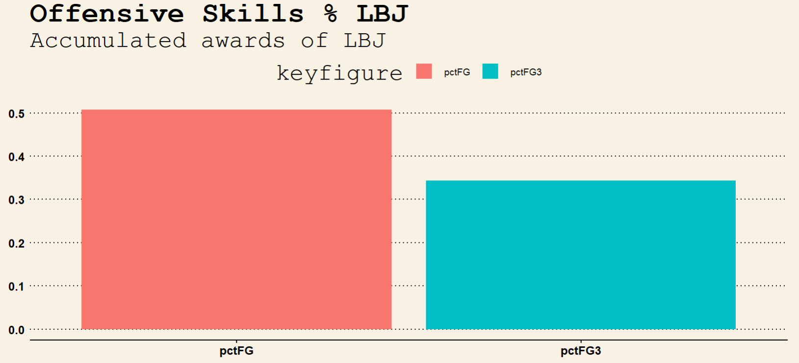
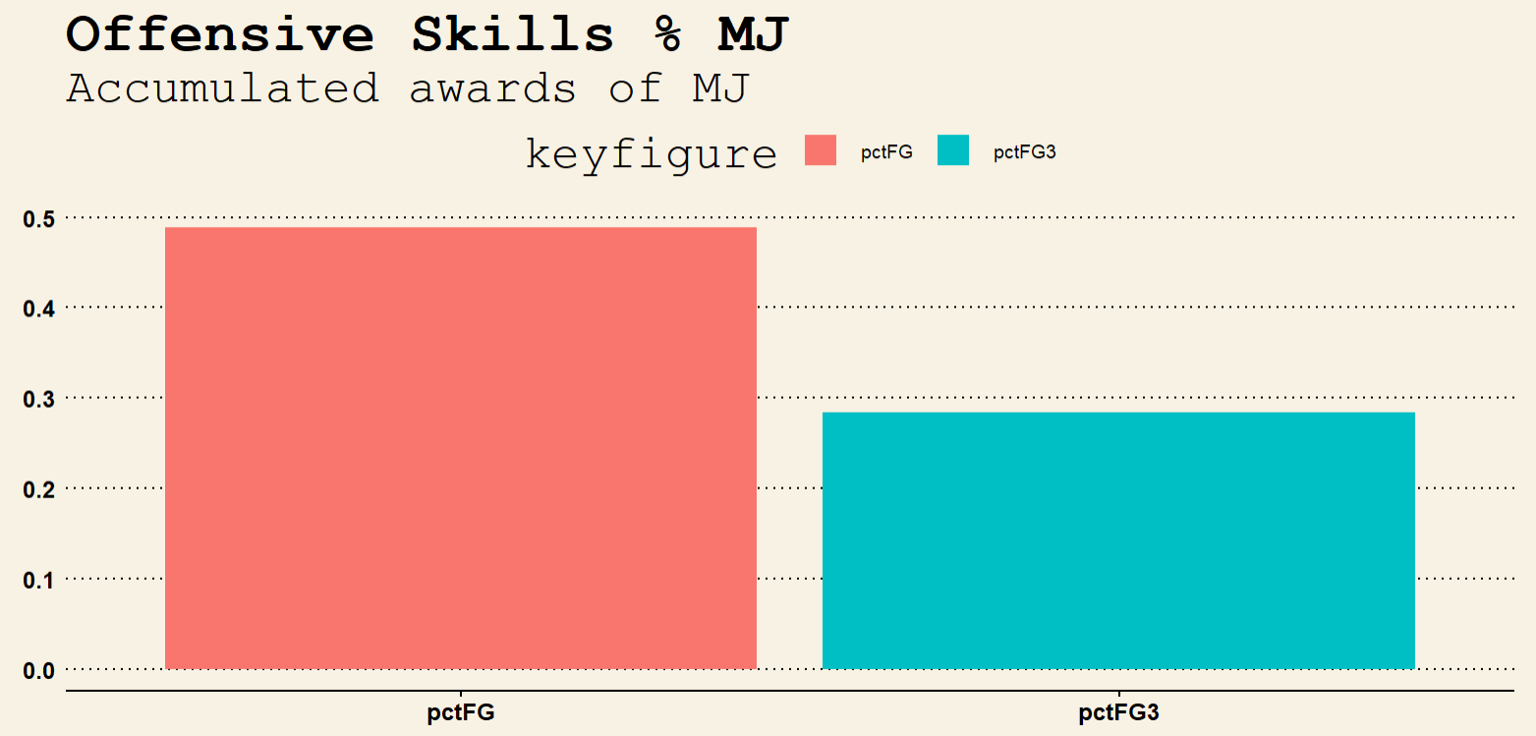
2-Offensiveness Percentage

Slide 14
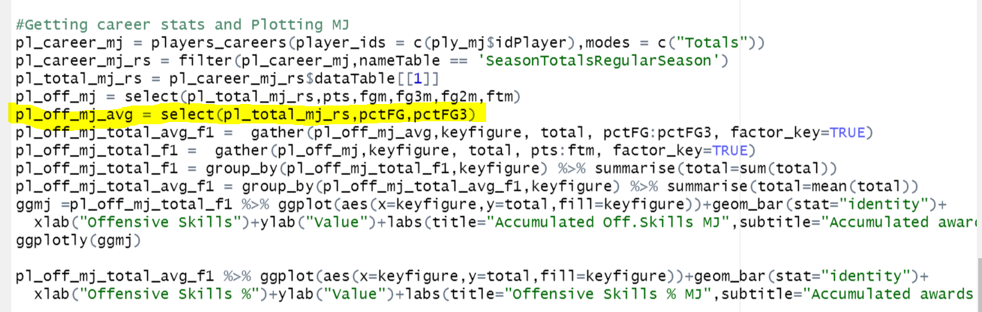
2-Offensiveness Percentage
We pretty much implemented the same code as in the previous plot, the only difference was the variables that we have used to show the Field Goals percentages

Slide 15
2-Offensiveness Percentage
Conclusion:
As the data suggest, LBJ is more effective than MJ. To really be honest, even I am surprise of theses facts, given the fact that MJ gives the impression that he is a more accurate player than LBJ
I think it all comes down, to the basket penetration. LBJ is taller than MJ and stronger, so it penetrates and attacks the basket more often. In that sense, the probability of making a shot is higher
One more thing, this data is based only in the regular season. MJ was remarkable during the postseason, and he substantially improved his level during the playoffs. The API allows you to extract this data. It will be really interesting to make that analysis, however for reasons of time, that analysis is outside the scope of this document

Slide 16
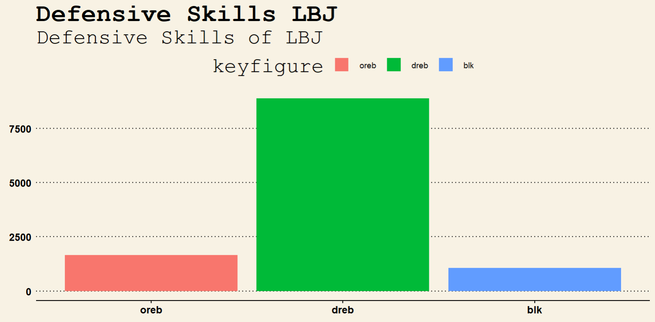
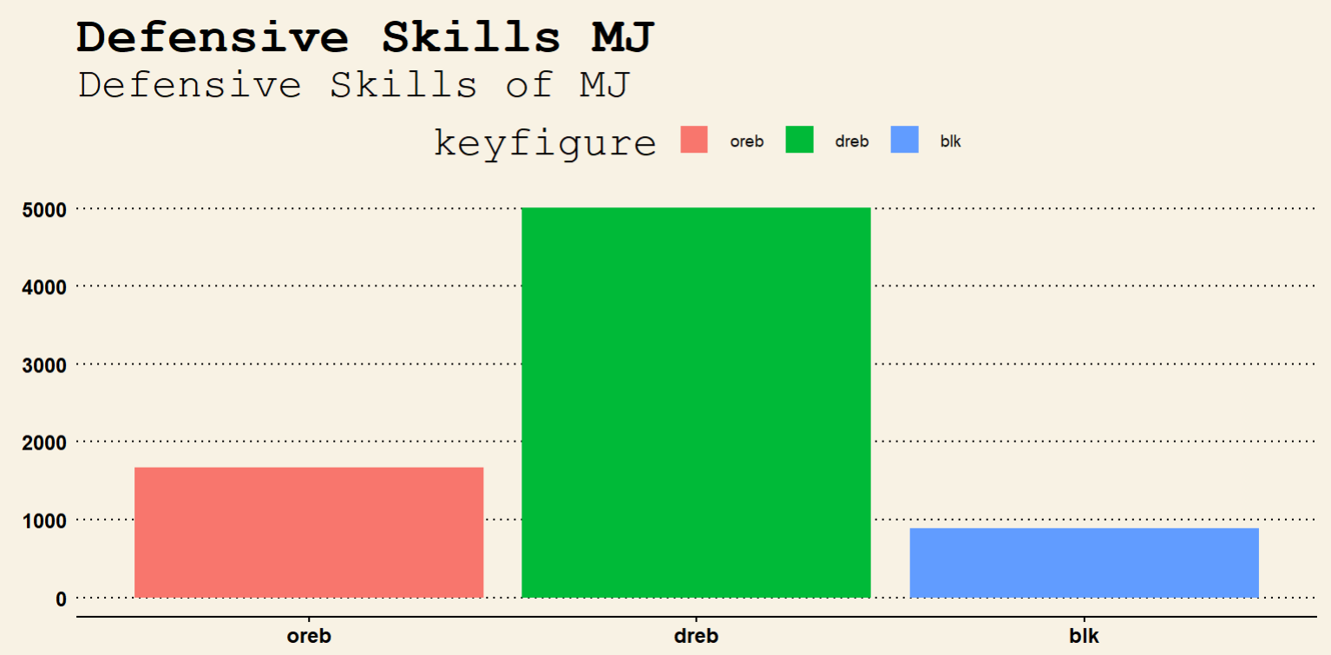
3-Defensiveness

Slide 17
3-Defensiveness
Conclusion:
As the data suggest LBJ has much more rebounds than MJ. For this reason, we believe LBJ is superior when it comes to a defensive player
Finally, we understand that based on this data LBJ is superior than MJ, however, there are other analysis we can run in order to strengthen our final decision such as the number of assistances
Another point, will be interesting to evaluate is the relationship between points by season against the season year using a scatterplot, it will give us an idea of the durability of the player, however, for reasons of time we were limited to do it
The complete implementation of this analysis is in my GIT repository, you are all very welcome to connect and use the examples
https://github.com/carlosAtestevez/SMU_MSDS_6306.git

Slide 18
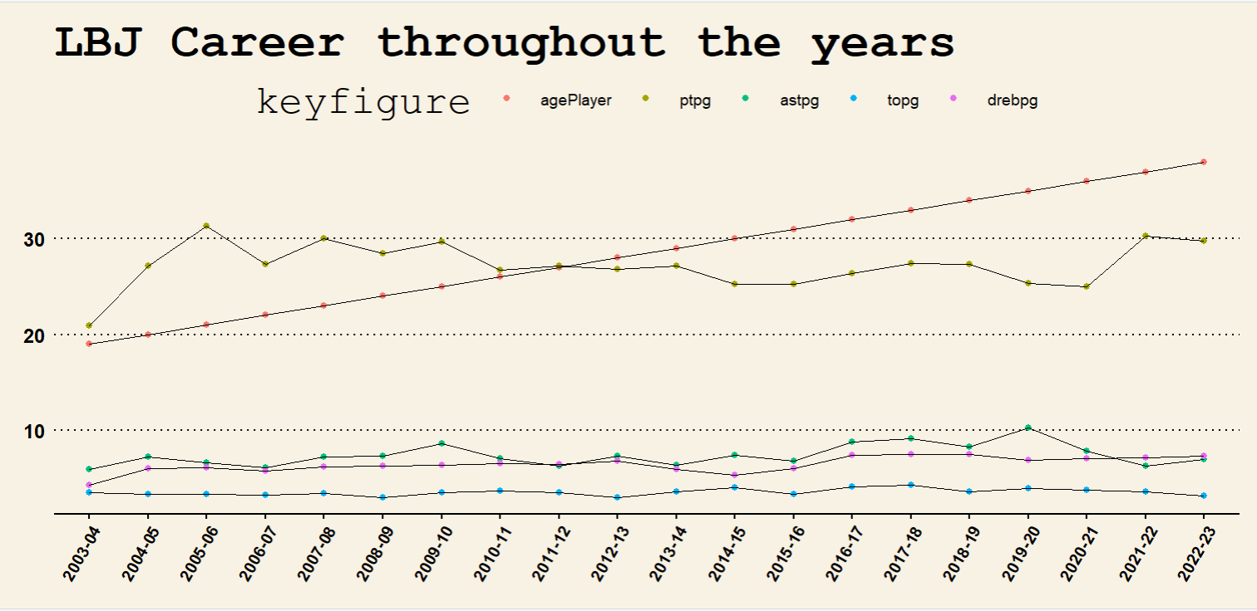
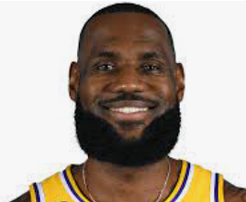
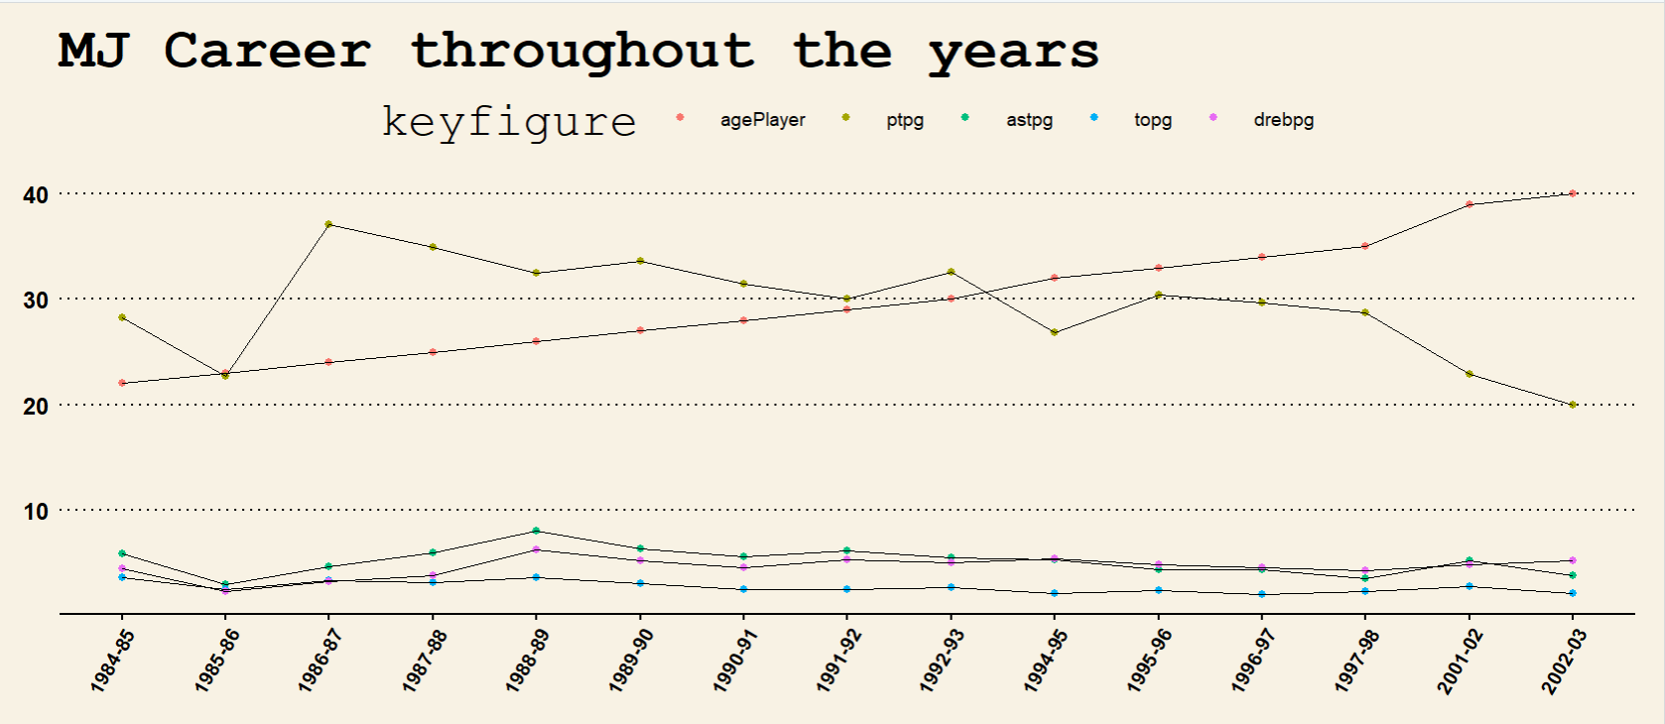

4.Longevity

Slide 19
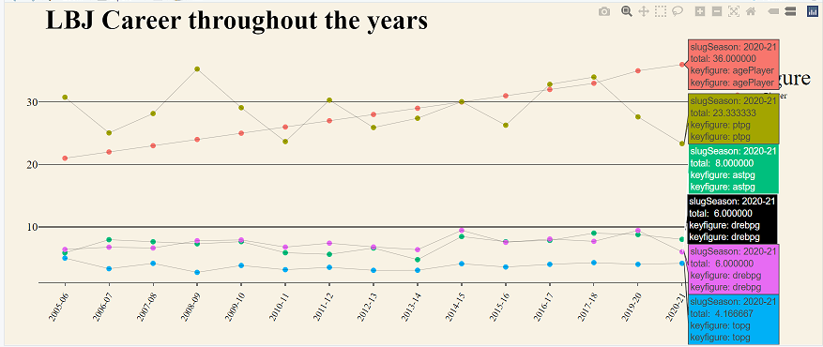
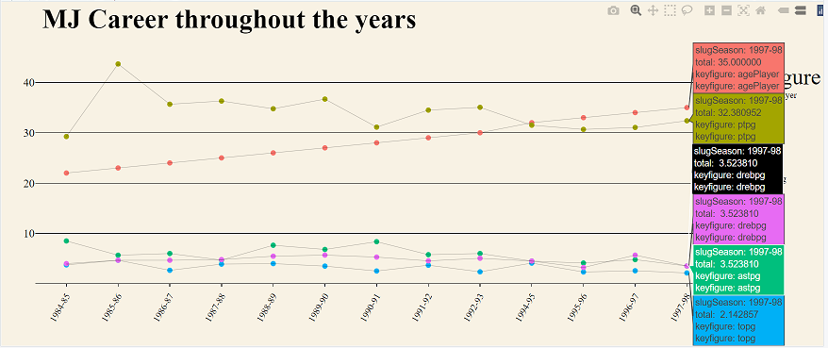
5.Post-Season performance

